Slide 1
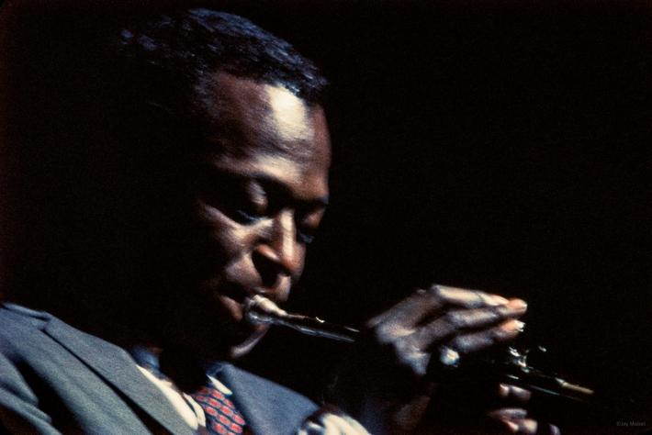
PROGETTO “DATAJAZZ”
Schembri Matteo Jacopo
1000012121

Slide 2

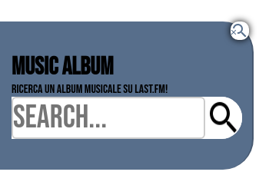
LAST.FM API
HTML
<button id=showsearch onclick="show_api()"> <img src ="img/icon/Last-fm-icon.png" id="showSearchLogo"> </button>
<div id="div_api">
<h1>Music album</h1>
<form>
<p>Ricerca un album musicale su last.fm!</p>
<span class="material-icons-outlined" onclick="show_api()">
&#xea76
</span>
<div id=lastfm_search>
<input type='text' id='album' placeholder="Search...">
<input type='image' name="submit" id='submit' src="img/icon/search-icon.png">
</div>
<div id="album-view"></div>
</form>
</div>
</div>

Slide 3
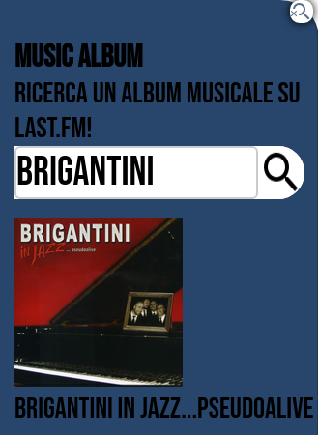
#div_api {
display: none;
align-items: center;
flex-direction: column;
justify-content: space-around;
margin-left: 0px;
margin-top: 50px;
position: absolute;
border-right: 2px solid #00000032;
background-color: #28466b;
border-top-right-radius: 40px;
border-bottom-right-radius: 40px;
padding-top: 40px;
padding-bottom: 40px;
padding-left: 15px;
width: 330px;
z-index: 4;
align-items: center;
}
#div_api img{
padding-top: 20px;
}
CSS
#div_api p{
font-size: 30px;
}
#div_api:focus{
outline: none;
}
.material-icons-outlined {
font-family: 'Material Icons';
font-size: 24px;
color: #28466bc7;
cursor:pointer;
box-shadow: 0 0 10px #000000;
border-radius: 10px;
position: absolute;
top: 0px;
left: 300px;
background-color: white;
}

Slide 4
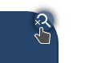
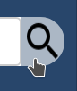
.material-icons-outlined:hover {
color: white;
background-color: #28466bc7;
}
#lastfm_search {
display: flex;
width: 300px;
background-color: white;
border-top-right-radius: 40px;
border-bottom-right-radius: 40px;
}
#submit {
background-color: white;
border-top-right-radius: 40px;
border-bottom-right-radius: 40px;
cursor: pointer;
}
#submit:hover {
background: #28466b63;
color: white;
}
#submit:focus {
outline: none;
}
#showsearch:focus {
outline: none;
}

Slide 5
JAVASCRIPT
function searchAPI(event)
{
// Impedisci il submit del form
event.preventDefault();
// Leggi valore del campo di testo
const album_input = document.querySelector('#album');
const album_value = encodeURIComponent(album_input.value);
rest_url = 'http://ws.audioscrobbler.com/2.0/?method=album.search&album=' + album_value + '&api_key=' + api_key + '&format=json';
console.log('URL: ' + rest_url);
fetch(rest_url).then(onResponse1).then(onJson1);
}
function onJson1(json) {
// Svuotiamo la libreria
const library = document.querySelector('#album-view');
library.innerHTML = '';
// Leggi il numero di risultati
const results = json.results.albummatches.album
let num_results = results.length;
// Mostriamone al massimo 5
if(num_results > 5)
num_results = 5;
for(let i=0; i<num_results; i++)
{
// Leggi il documento e le informazioni
const album_data = results[i]
const title = album_data.name;
const images = album_data.image;
let selected_image = null;
for(image of images)
{
if(image.size == 'large')
selected_image = image['#text'];
}

Slide 6
function show_api(id){
let x = document.getElementById("div_api");
let y = document.getElementById("showsearch");
if (x.style.display === ""){
x.style.display = "block";
y.style.display = "none";
}else{
x.style.display = "";
y.style.display = "block";
}
}
// API key --- METODO NON SICURO!
const api_key = 'a48553ca5408fc2c14ae058f742c2e0c';
const form = document.querySelector('form');
form.addEventListener('submit', searchAPI);
// Creiamo il div che conterrà immagine e didascalia
const album = document.createElement('div');
album.classList.add('album');
const img = document.createElement('img');
img.src = selected_image;
const caption = document.createElement('p');
caption.textContent = title;
album.appendChild(img);
album.appendChild(caption);
library.appendChild(album);
}
}
function onResponse1(response) {
console.log('Risposta ricevuta');
return response.json();
}

Slide 7
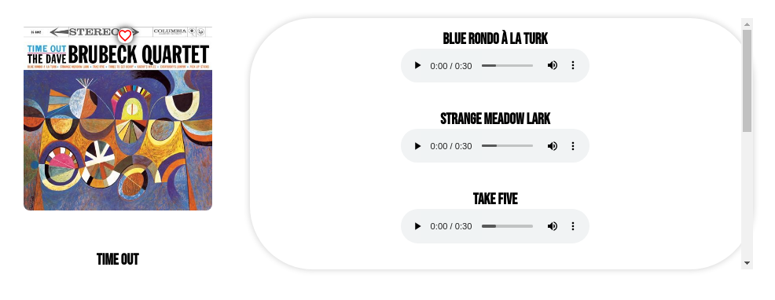
SPOTIFY API

Slide 8
JAVASCRIPT
// Dichiara variabile token
let token;
// All'apertura della pagina, richiediamo il token
fetch("https://accounts.spotify.com/api/token",
{
method: "post",
body: 'grant_type=client_credentials',
headers:
{
'Content-Type': 'application/x-www-form-urlencoded',
'Authorization': 'Basic ' + btoa(client_id + ':' + client_secret)
}
}).then(onTokenResponse).then(onTokenJson).then(searchItemFromSpotify);
function onResponse(response) {
return response.json();
}
function onTokenJson(json)
{
// Imposta il token global
token = json.access_token;
}
function onTokenResponse(response)
{
return response.json();
}
// OAuth credentials --- NON SICURO!
const client_id = 'a3d490c5fd084afe820e482860e3c59e';
const client_secret = '1bee37a7a4f3468f9e0c1f18ec16ad27';

Slide 9
function searchItemFromSpotify(){
album.forEach((element, indiceProva) => {
let copiaTitolo = element.titolo;
let titoloEncoded = encodeURI(copiaTitolo);
titoloEncoded = titoloEncoded.toLowerCase();
console.log(titoloEncoded);
let urlAlbum = "https://api.spotify.com/v1/search?q=" + titoloEncoded + "&type=album&market=IT&limit=1"
console.log(urlAlbum)
fetch(urlAlbum,
{
headers:
{
'Authorization' : 'Bearer ' + token
}
}
).then(response => onResponse(response))
.then(data => searchAlbumFromSpotify(data, indiceProva));
});
}
function searchAlbumFromSpotify(json, indiceProva){
console.log(json)
let resultSearch = json.albums.items[0].id;
console.log(resultSearch);
//esegui la richiesta
fetch("https://api.spotify.com/v1/albums/" + resultSearch + "/tracks?market=IT",
{
headers:
{
'Authorization' : 'Bearer ' + token
}
}
).then(response => onResponse(response))
.then(data => onJson(data, indiceProva));
}

Slide 10
let indice = 0;
function onJson(json, indiceProva) {
console.log(indiceProva)
let results = json.items;
const musicDiv = document.querySelector("#spotifyDivId-" + indiceProva);
indice ++;
results.forEach((element) => {
let track_div = document.createElement("div");
track_div.className = "track_div_class";
let titolo_brano = document.createElement("h1");
titolo_brano.textContent = element.name;
track_div.appendChild(titolo_brano);
let sound = document.createElement('audio');
if(element.preview_url!= null){
sound.id = 'audio-player';
sound.controls = 'controls';
sound.src = element.preview_url
track_div.appendChild(sound);
} else {
let notFound = document.createElement("p");
notFound.textContent = "The following preview is not avaible :(";
track_div.appendChild(notFound);
}
musicDiv.appendChild(track_div);
});
}

Slide 11
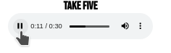
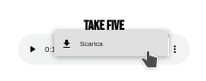


CSS
.albumBoxClass {
columns: 2;
position:relative;
display: flex;
align-items:flex-end;
flex-direction: row;
padding: 30px;
}
.track_div_class {
padding: 20px;
}
.spotifyDivClass {
border-radius: 100px;
box-shadow: 0 0 10px #cecece;
width: 800px;
max-height: 400px;
overflow: auto;
}
#audio-player:focus {
outline: none;
}

Slide 12
Grazie per l’attenzione
Schembri Matteo Jacopo
Kind of Blue recording session 1958 Kind of Blue © Jay Maisel

